Slide 1

Evaluation of SHViT for Volumetric Semantic Segmentation in Industrial CT Scans
ChangGeng Drewes
Advisor: Martin Leipert

Slide 2
So far …

Slide 3
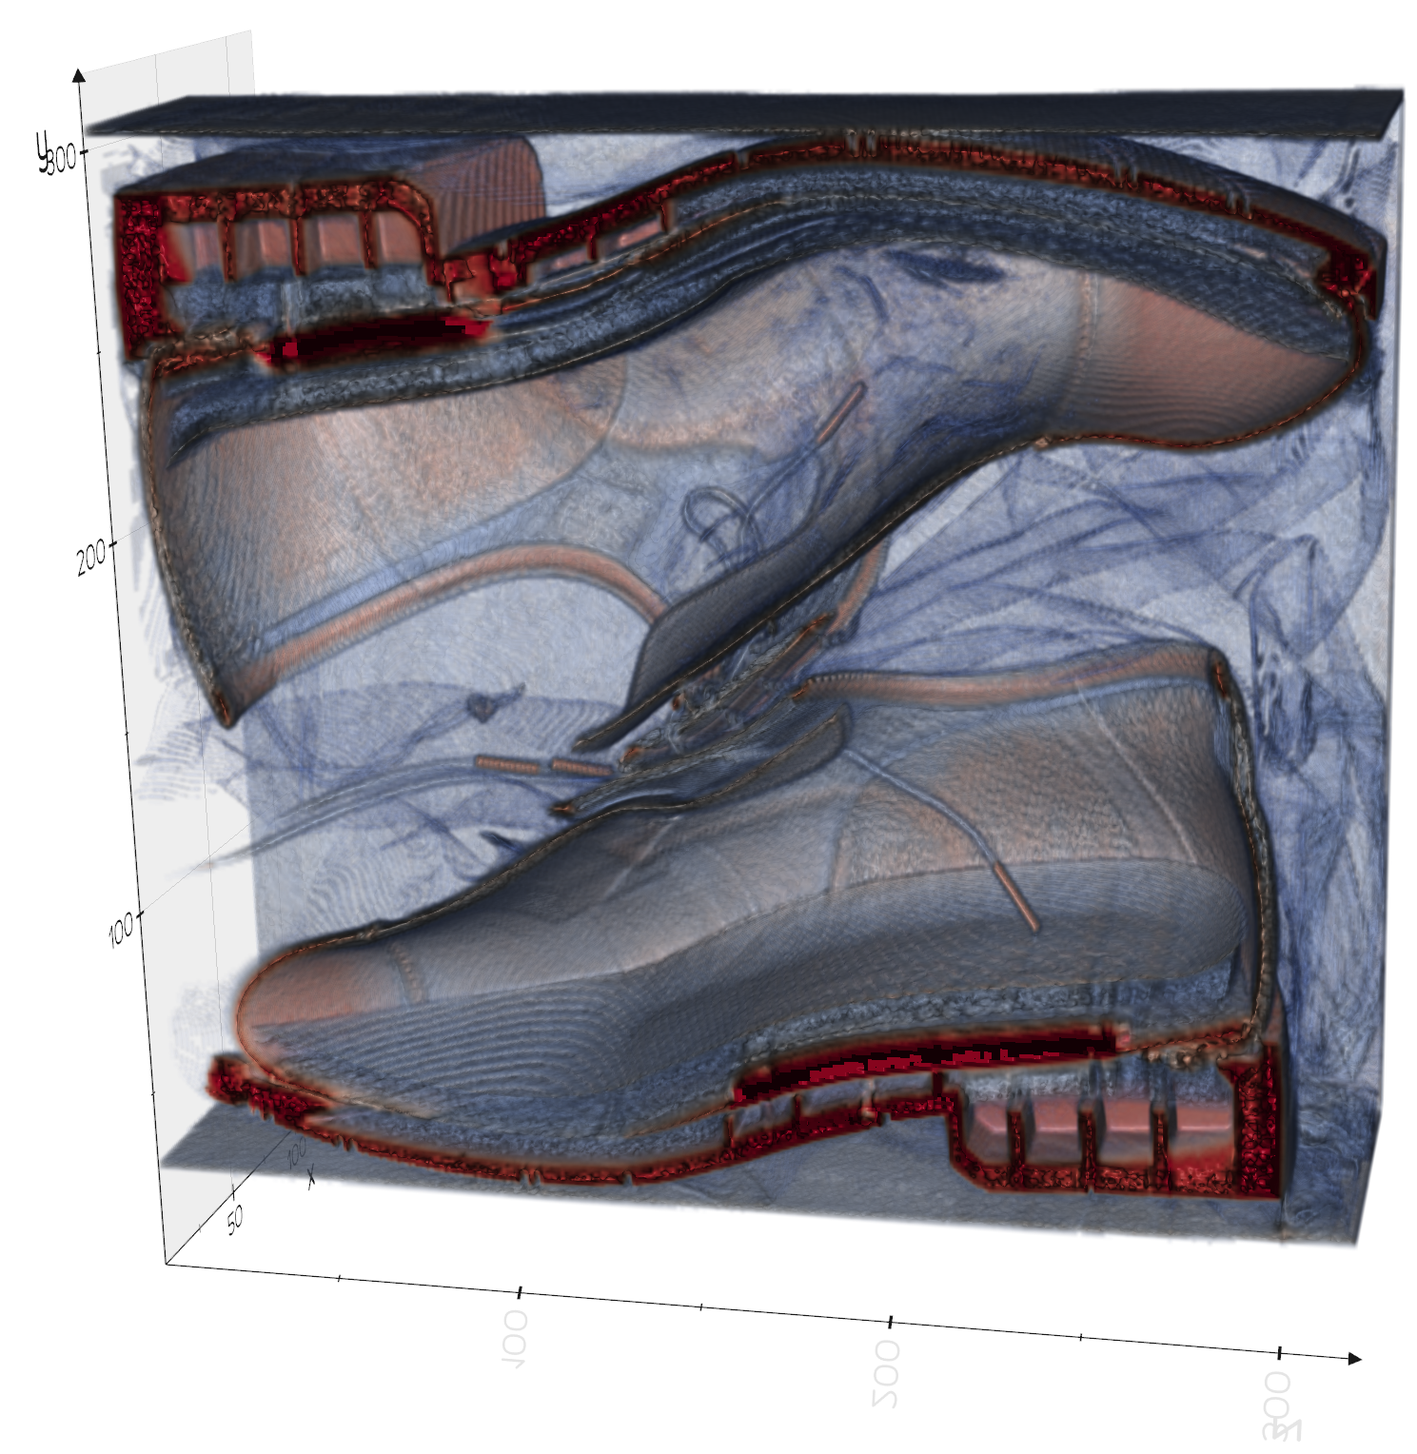
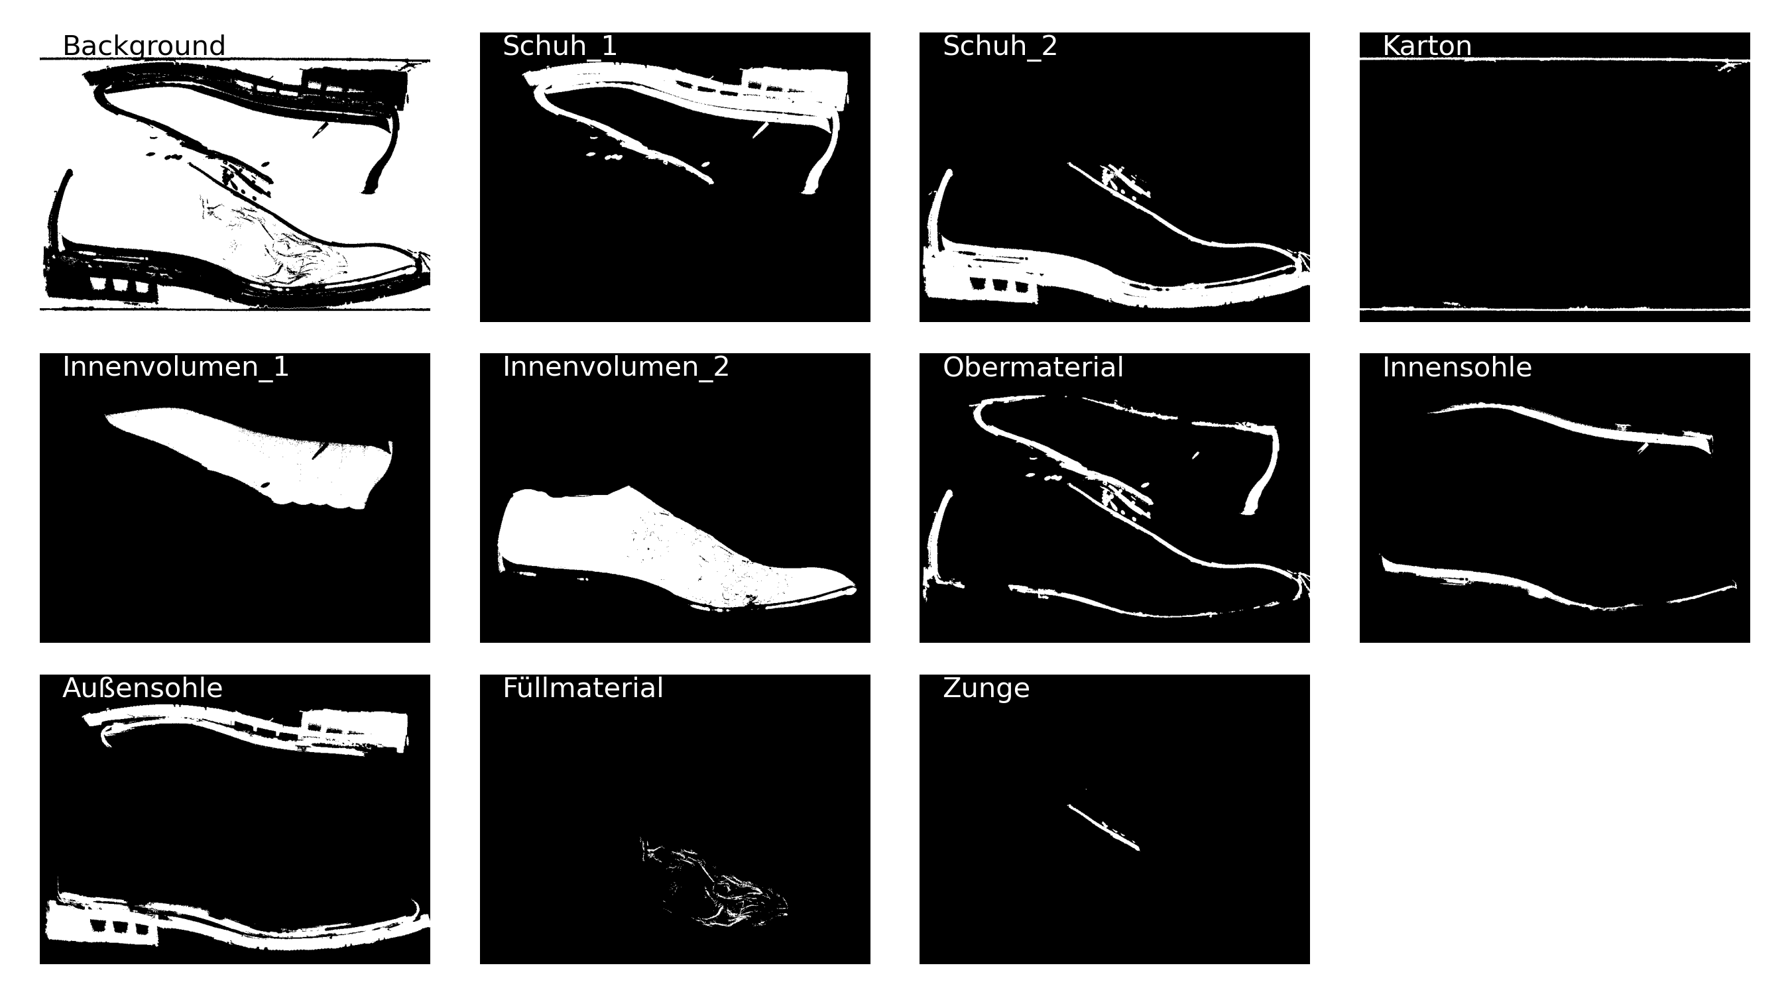
Dataset
40 high-resolution 3D CT-scans of shoes in boxes
Ground truth labels are:
cardboard, outsole, insole, upper material, tongue, filling material, background

Slide 4
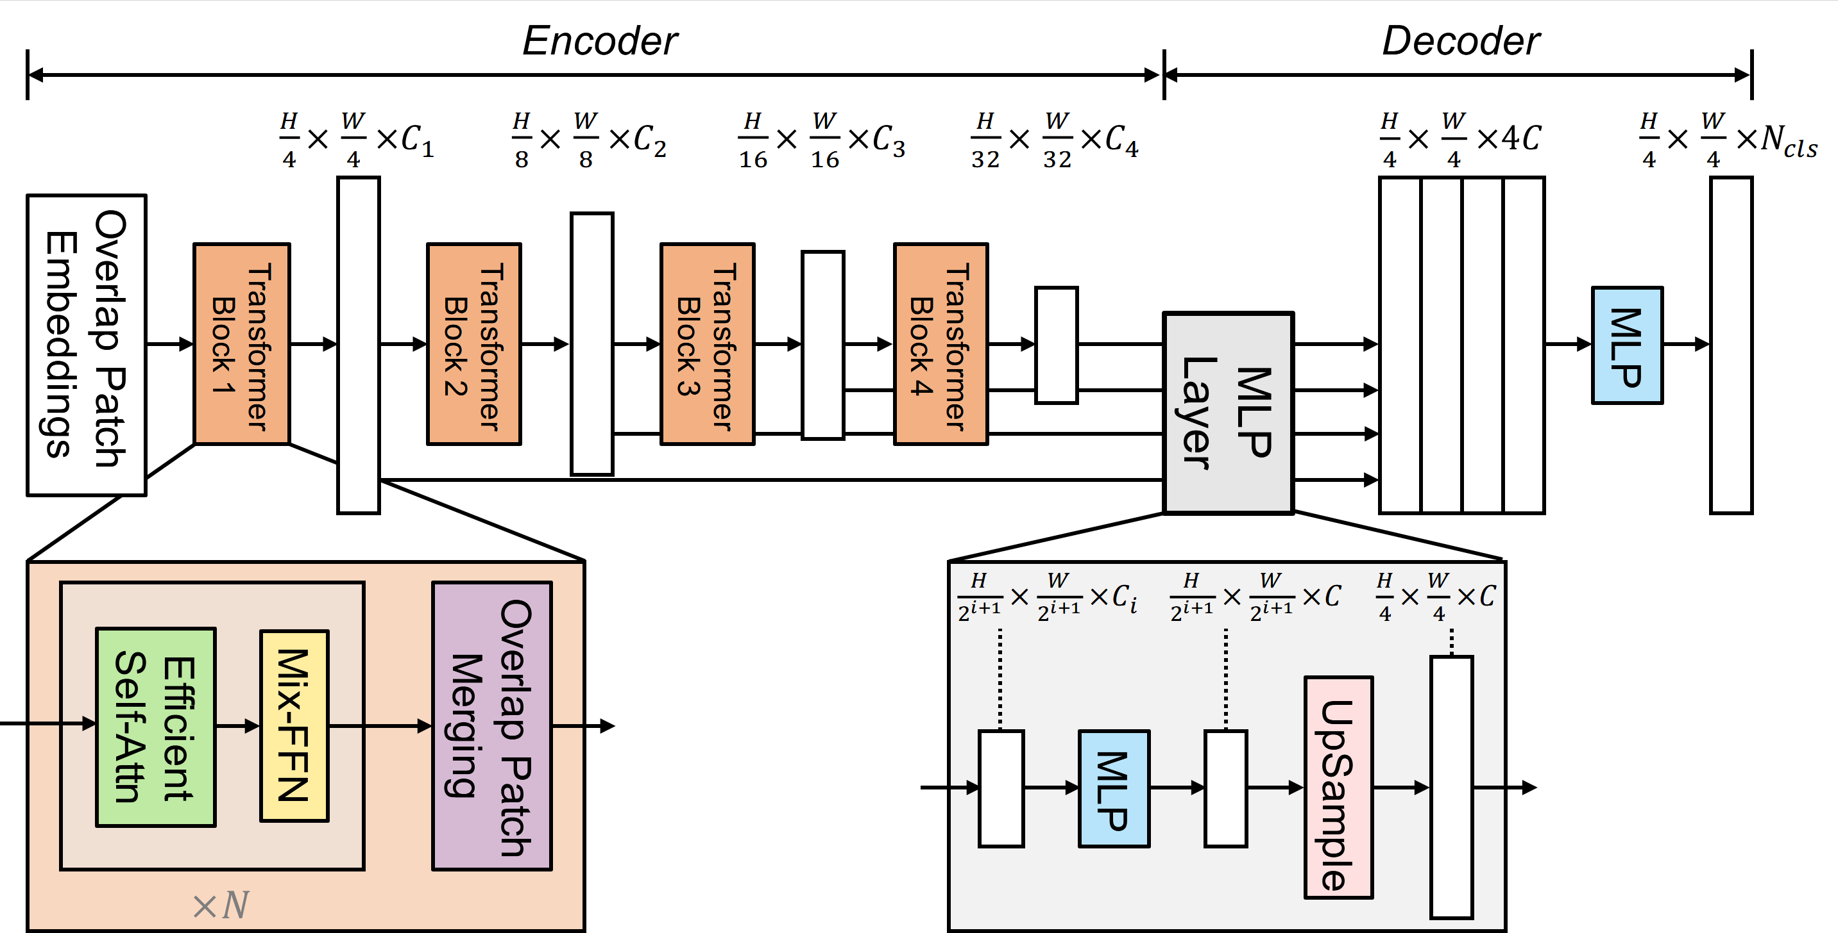
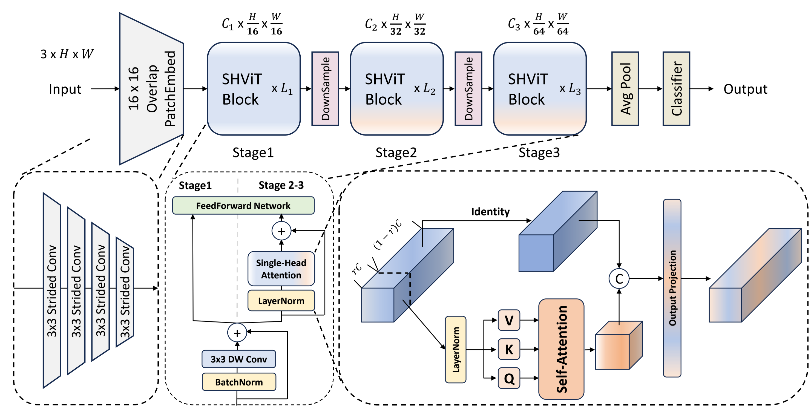
Architecture of MixViT and SHViT

SHViT-Segformer
Notes:
"mit_b5": {
"embed_dims": [64, 128, 320, 512],
"depths": [3, 6, 40, 3],
"decode_dim": 768,
},
"SHViT_s2": {
"embed_dims": [128, 308, 448],
"partial_dims": [32, 66, 96],
"depths": [2, 4, 5],
"types": ["i", "s", "s"],
},

Slide 5
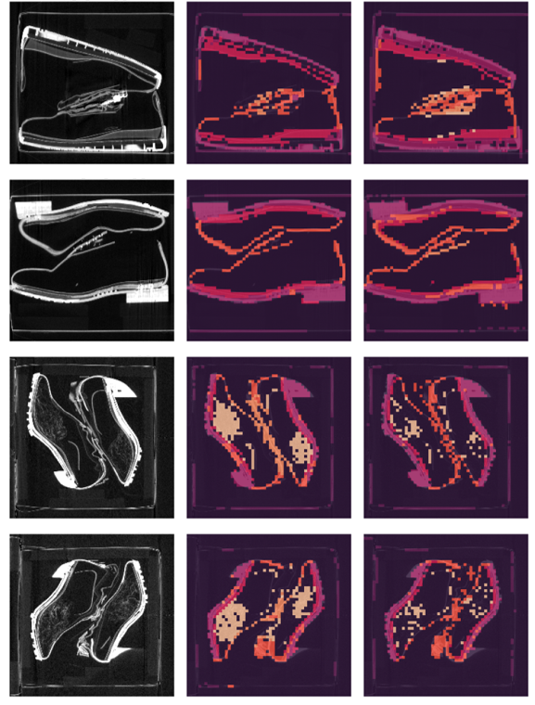
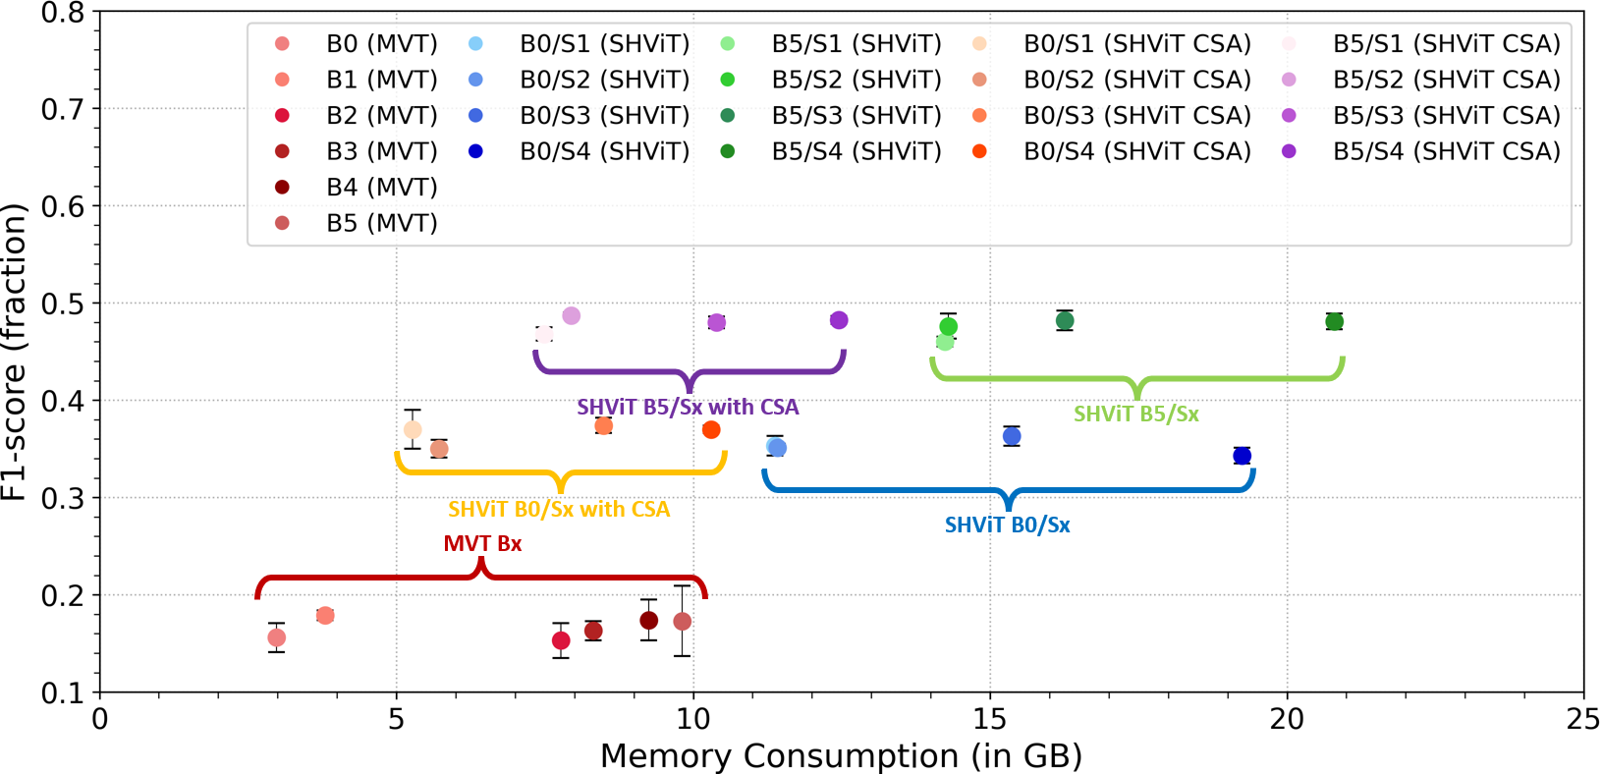
Results of the first experiment
Notes:
3D-SHViT model with central self-attention
From left to right: the input image, the predicted segmentation, and the corresponding
ground truth segmentation image for each of the two columns.

Slide 6
… Today …

Slide 7
Agenda
01
Objectives
02
Methodology
03
Experiment / Results and Discussion
04
Conclusion / Future Work

Slide 8
Objective

Slide 9
Next steps / Objectives
Evaluating Maximum Volume Size for SHViT on a 24 GB GPU
Impact of Convolutional Depth (number of layers) on F1-Score
Effects of Kernel Size on F1-score and Memory
Segmentation performance: SHViT versus CNN (Martins Paper)

Slide 10
Methodology

Slide 11
Implementation
Data Generator / Data Loader
Load input data (image and annotation files)
Data Augmentation (rotation, flipping, brightness, contrast)
KFold-CrossValidation
Split: training / validation: 4/1 (k = 5)
Training
WarmUp (20 Epochs with Learning Rate Scheduler), Earlystopping (50 Epochs)
Best Validation Loss and F1-Score (Averaged)
Conducted each experiment five times
Final Output
Loss and F1-Score (Mean and standard deviation)
Notes:
Experimentdurchführung
=================
For training: shuffle and augmentation
For validation: no shuffle and no augmentation
learning rate:
Wenn die Validationerror für eine gewisse Anzahl von Epochen nicht reduziert wird, dann wird lr halbiert
Early stopping, wenn Valloss innerhalb 50 Epochen nicht besser geworden ist, dann wird training gestoppt

Slide 12
Experiment / Results

Slide 13
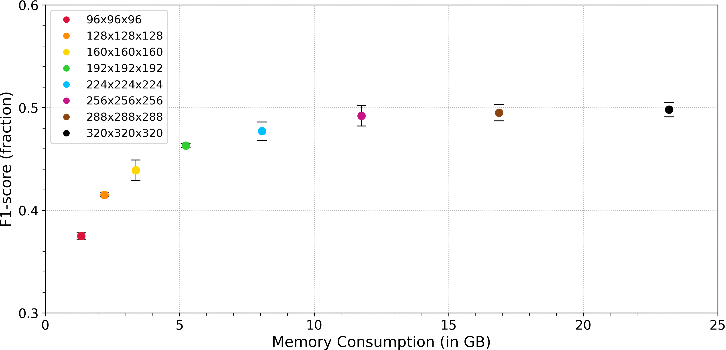
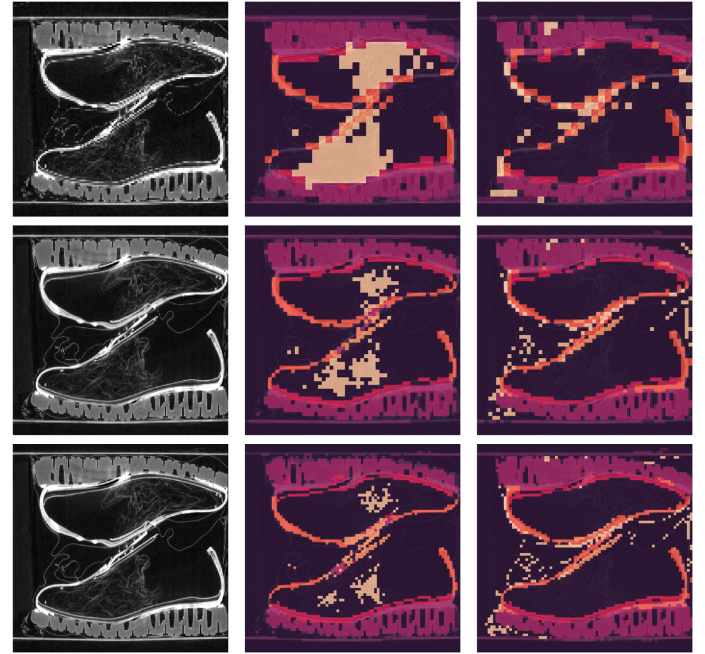
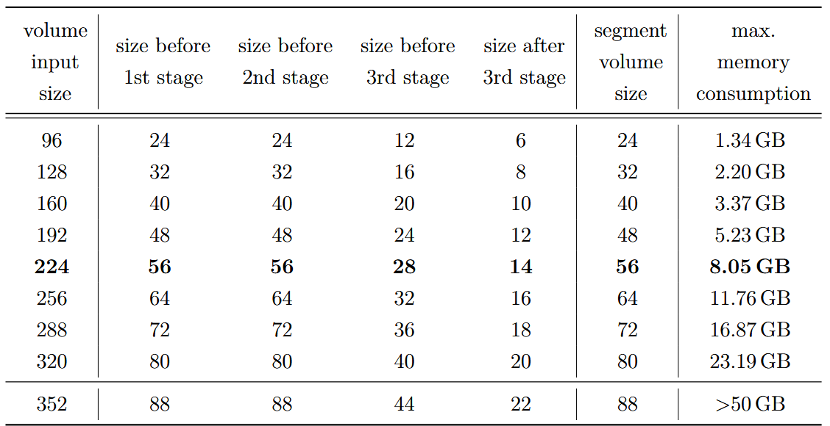
Experiment
Evaluation of Maximum Volume Size for SHViT on a 24 GB GPU
image prediction ground thruth
128x128x128
224x224x224
320x320x320

Slide 14
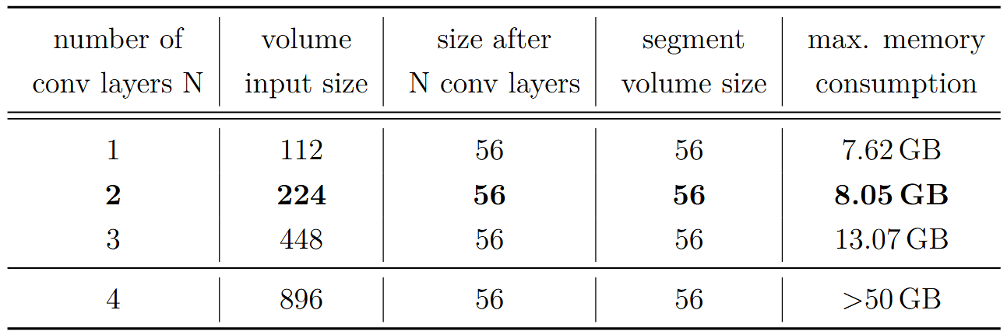
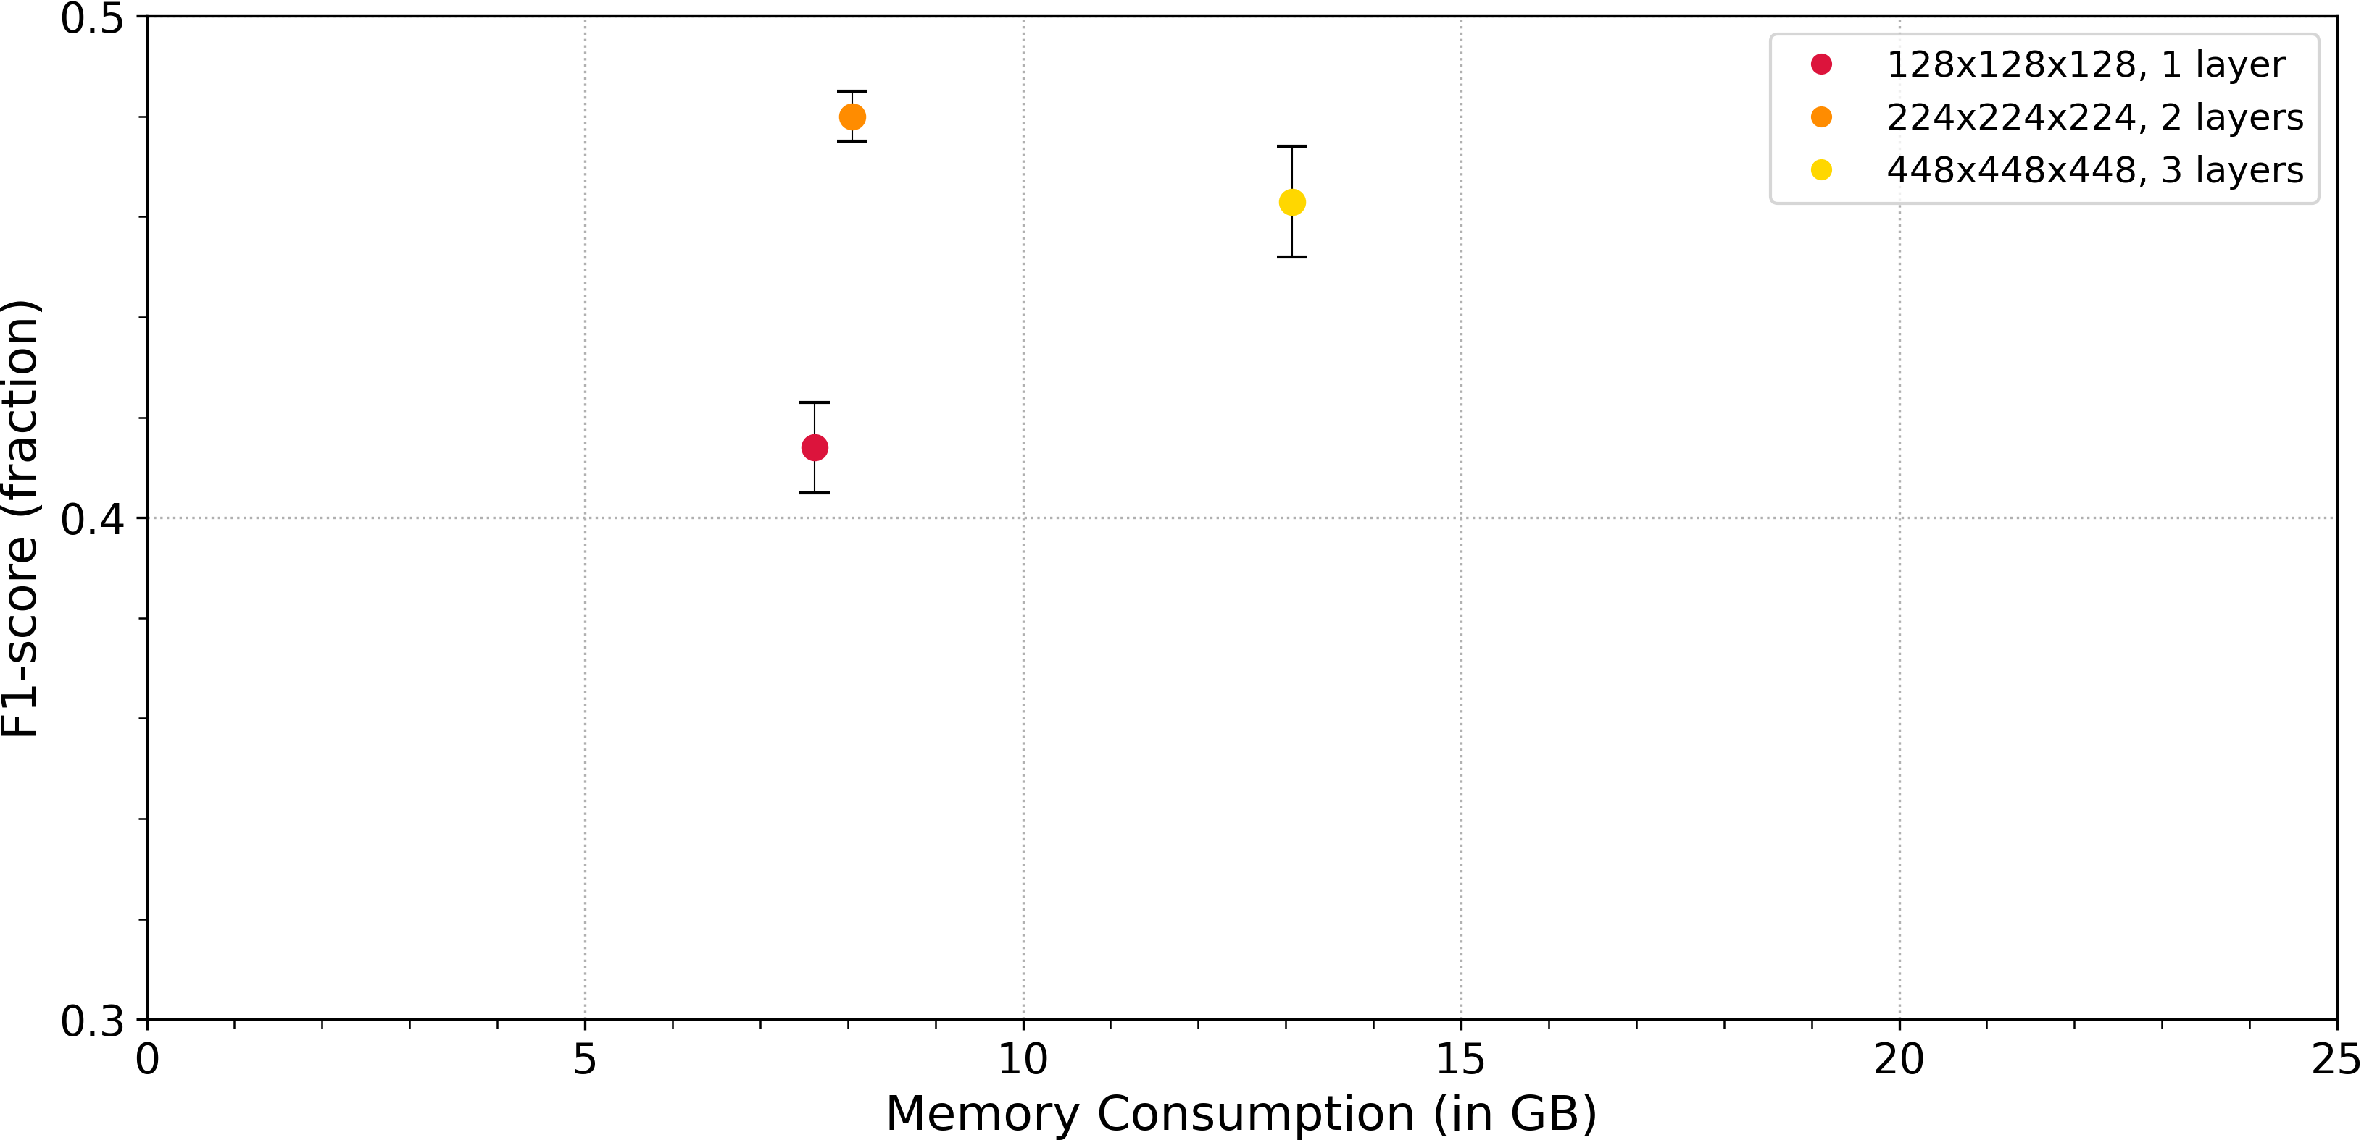
Experiment
Impact of Convolutional Depth on F1-score
Overview of input volume sizes and their corresponding segmentation resolutions of the SHViT CSA B5/S2-model for different number of convolutional layers.
F1-score versus GPU memory consumption for different number of convolutional layers and volume sizes keeping segmentation volume same. The experiment with 4 convolutional layers was not executed due to very high memory demand.

Slide 15
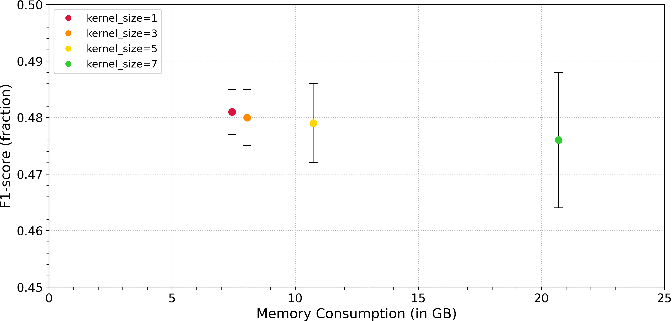
Experiment
Effects of Kernel Size on F1-score and Memory
Configuration: SHViT CSA (B5/S2) N=2 224x224x224
F1-score versus GPU memory consumption for different kernel sizes

Slide 16
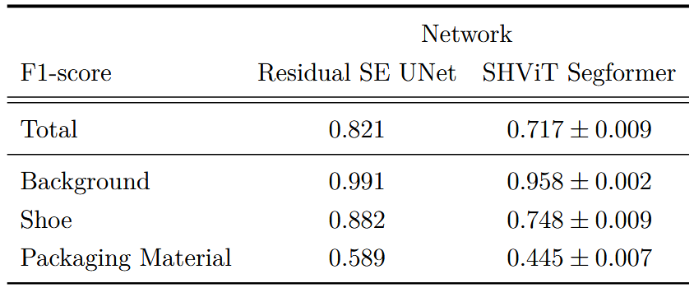
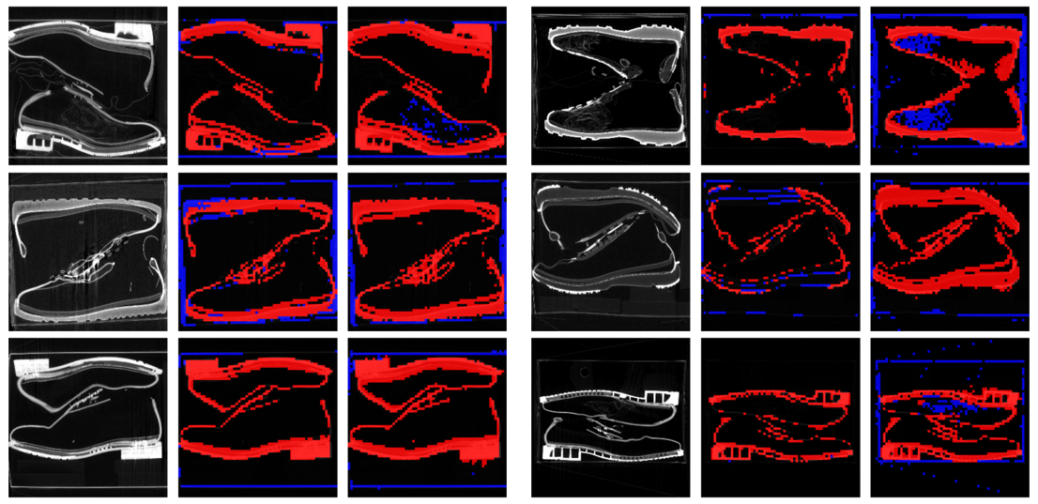
Experiment
Segmentation performance: SHViT versus CNN
image prediction ground thruth
image prediction ground thruth
Comparison of segmentation performance (F1-scores) between the Residual SE UNet and SHViT Segformer models across three different classes. The UNet model consistently outperforms SHViT Segformer, particularly for the »Shoe« and »Packaging Material« categories
Configuration: SHViT CSA (B5/S2) N=2, KS=3, 256x256x256
Results of shoes with 3 segments: background, shoe, and packaging material.
Left images: high F1-score, right images: low F1-score
Notes:
Experiments 1-3: Comparative Analysis with Published Work
Experiments 1
Results of shoes with 3 segments: background, shoe, and packaging material. From left to right: the input image, the predicted segmentation, and the corresponding ground truth segmentation image for each of the two
columns. The images on the left have high overal F1-score

Slide 17
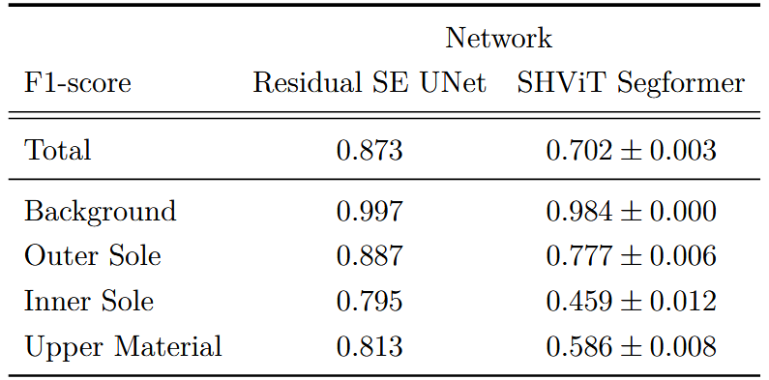
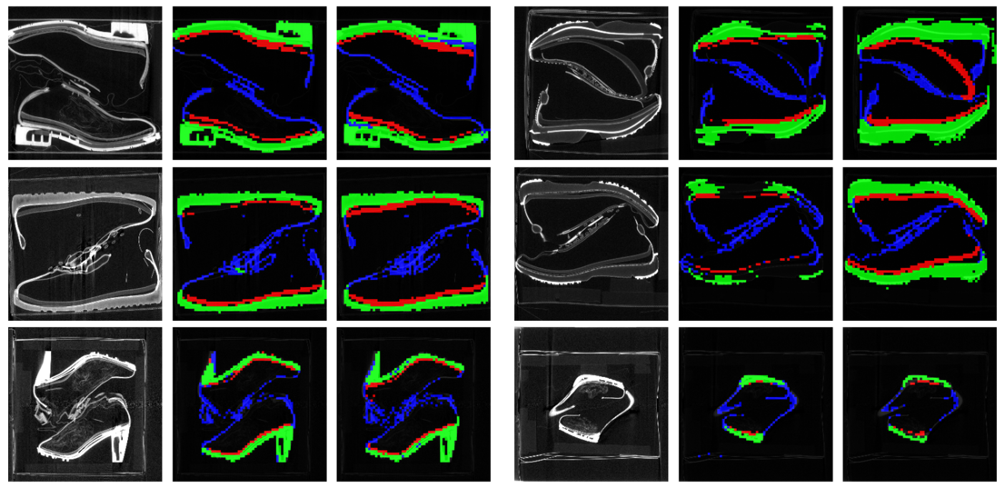
Experiment
Segmentation performance: SHViT versus CNN
image prediction ground thruth
image prediction ground thruth
Comparison of segmentation performance (F1-scores) between the Residual SE UNet and SHViT Segformer models across four different classes. The F1-score of UNet model for the segments »Inner Sole« and »Upper Material« is higher then for SHViT Segformer model
Results of shoes with 4 segments: background, outer sole, inner sole, upper material
Left images: high F1-score, right images: low F1-score
Configuration: SHViT CSA (B5/S2) N=2, KS=3, 256x256x256
Notes:
Experiments 1-3: Comparative Analysis with Published Work
Experiments 3
Results of shoes with 3 segments: background, shoe, and packag-
ing material. From left to right: the input image, the predicted segmentation,
and the corresponding ground truth segmentation image for each of the two
columns. The images on the left have high overal F1-score

Slide 18
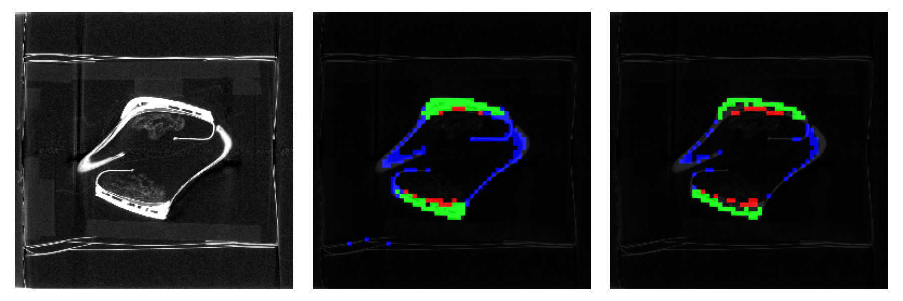
Experiment
Segmentation performance: SHViT versus CNN
image prediction ground thruth
Notes:
Experiments 1-3: Comparative Analysis with Published Work
Experiments 3
Results of shoes with 3 segments: background, shoe, and packag-
ing material. From left to right: the input image, the predicted segmentation,
and the corresponding ground truth segmentation image for each of the two
columns. The images on the left have high overal F1-score

Slide 19
Experiment
Summary of SHViT comparison with Unet CNN
Transformers perform worse than CNNs on small datasets – even with augmentation
CNNs excel at capturing fine details due to skip connections
Transformers need more training time
Transformers resolve fine details less effectively – especially when trained from scratch (like ours)

Slide 20
Conclusion / Future Work

Slide 21
Conclusion
Recommended Model Configuration
3D SHViT-SegFormer
with central self-attention and B5/S2 configuration
two convolutional heads in the overlap patch embedding
kernel size of the central self-attention layer is 3
Results
F1-score of 0.485 for input volume of (224,224,224)
memory consumption of 8.05 GB
training time of around 13 seconds per epoch
With this configuration input volumes up to (320,320,320) are possible
Notes:
F1-score of 0.485 for input volume of (224,224,224)
memory consumption of 7.94 GB
training time of around 13 seconds per epoch
With this configuration input volumes up to (320,320,320) are possible

Slide 22
Future Work
Backbone Extension
Explore additional Vision Transformer models as backbones
Compare their performance with SHViT
Memory Demand:
High memory consumption of attention blocks remains a challenge
Advanced techniques may help reduce memory usage
Input Volume Scaling:
Current maximum: (320, 320, 320), limited by 24 GB GPU memory
Next possible size (352, 352, 352) is desirable but hard to achieve
Need for Innovative Strategies:
Goal: Enable efficient scaling without exceeding hardware limitations
Notes:
Future research could explore the implementation of additional Vision Transformer
models as backbones and compare their performance with SHViT. Addressing the high
memory demand of the attention block remains an area for investigation. New advanced
techniques might offer further potential for reducing memory consumption. However, going
beyond the currently maximal usable volume of (320,320,320) may prove challenging due
to the constraints imposed by the 24 GB limit of the graphics card. For SHViT models
with two convolutional layers in the PatchEmbed block within the SHViT head, the next
larger volume would be (352,352,352), but for sure hard to reach. Therefore, innovative
strategies are needed to enable efficient scaling without surpassing hardware limitations. New advanced
techniques might offer further potential for reducing memory consumption

Slide 23
Thank you for your Attention

Slide 24
Thank you for your Attention
Because Attention is all you need!!

Slide 25
Backup

Slide 26
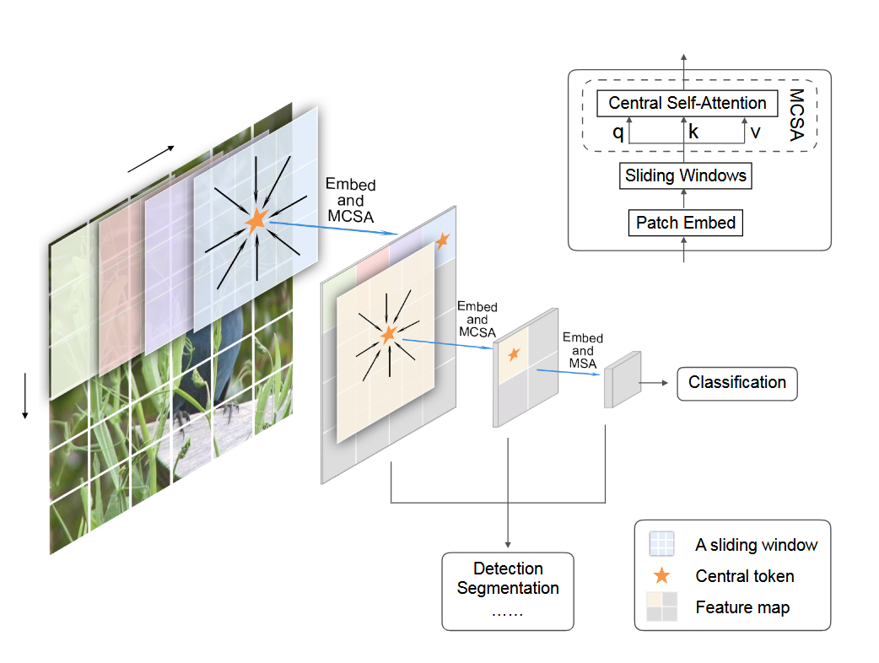
Central Self Attention
Attention Block with qk^{T} with O(n²)
Idea: use Central Self-Attention
(simViT Paper)
distant areas have weak relationships focus on local point and its immediate neighbors
-> Single head central self attention
Notes:
Von Stage 2 auf Stage 3 reduziert sich die Resolution von 28 auf 14
1. CNN uses weighted filters, Sliding Window uses Attention
On the other hand, CNNs have proved the importance of preserving the highly local relations with regional connections in convolution kernels.
Convolutions with sliding windows naturally capture the 2D spatial information without additional position encodings.
They applied overlapping sliding windows to establish cross-window dependencies
2. CNNs use shared weights, sliding windows work depending on data
...the computation of responses is only related to shared weights and ‘pixels’ within the same window.
Within each window, we propose MCSA to establish the highly local dependencies between the central patch and surrounding patches.

Slide 27
Memory consumption in attention block
Example with an input shape: (224,224,224)
Problem:
After Overlap Patch Embedding Block: (56,56,56)
After Stage 1: (28,28,28) [is input size into stage 2]
Stage 2 with attention block:
q, k, v with each dimension: (…, 28,28,28)
After flattening the spatial dimensions, the shapes become:
q, k, v shape: (…, 21952)
q^T*k : 21952 * 21952 = 480 Million elements (a lot)
For an input image shape (448,448,448) then q^T*k = 30,840,979,456 = 31 Billions elements
-> Solution (applying central self attention)
Notes:
Grenze mit sw: 320, 320, 320
Grenze ohne sw: 224x224x224
Solution (applying central self attention)

Slide 28
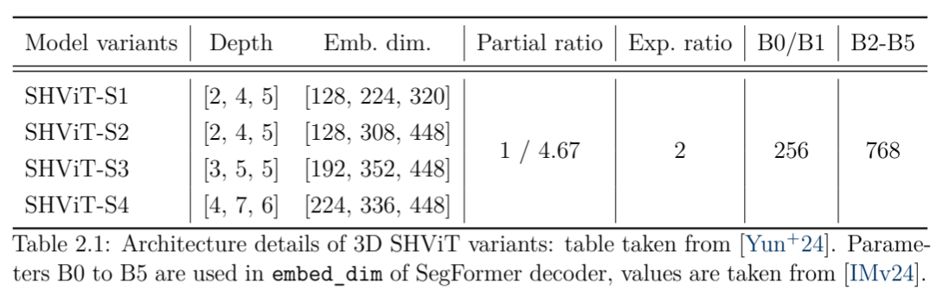
Architecture details of 3D SHViT variants
Notes:
The depth is the number of blocks in the stages.
The embedded dim in each stage

Slide 29
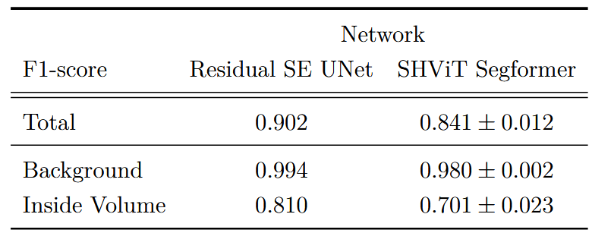
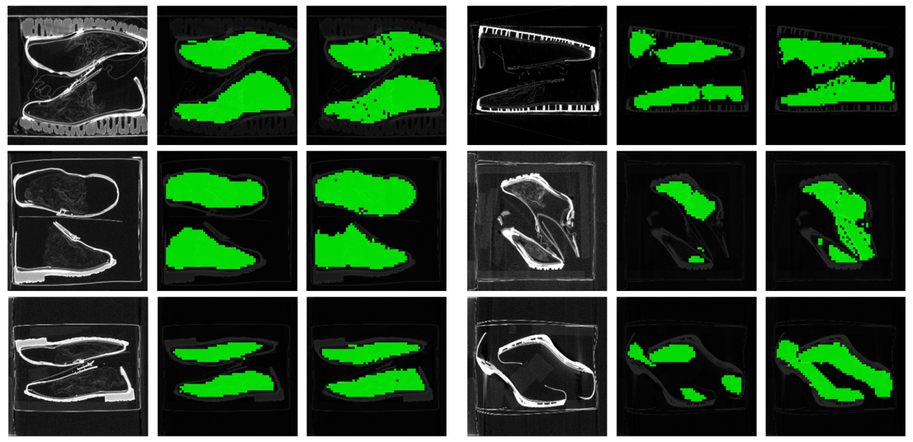
Experiment
Segmentation performance: SHViT versus CNN
Comparison of segmentation performance (F1-scores) between the Residual SE UNet and SHViT Segformer models across two different classes. The UNet model achieves higher overall performance due to the better prediction of the »Inside Volume«
Notes:
Experiments 1-3: Comparative Analysis with Published Work
Experiments 2
Results of shoes with 3 segments: background, shoe, and packag-
ing material. From left to right: the input image, the predicted segmentation,
and the corresponding ground truth segmentation image for each of the two
columns. The images on the left have high overal F1-score

Slide 30
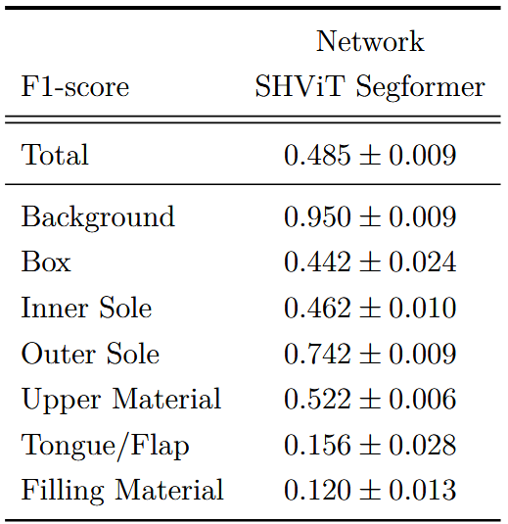
Experiment
Segmentation performance: SHViT versus CNN
Segmentation performance (F1-scores) of the SHViT Segformer across seven classes. Results for the Residual SE UNet are not available for this experimental setup. The model performs well on large structures like »Background« and »Outer Sole«, but struggles with fine-grained regions such as »Filling Material« and »Tongue / Flap«

